Slide 1
METERING & MONETIZATION PLATFORM
Metering Engine
Architecture & design of the end-to-end pipeline — from billable events to aggregation, monetization, and billing.
Ingestion · Processing · Aggregation · Monetization
Notes:
Metering Engine: the end-to-end pipeline that turns billable API events into aggregated, billable, reportable data.

Slide 2
01 — OVERVIEW
One pipeline, end to end
Billable API events are captured at the edge, processed into columnar storage, aggregated on a schedule, and served to monetization, billing, and analytics from a lightweight store.
PHASE 01
PHASE 02
PHASE 03
PHASE 04
Ingestion
Processing
Aggregation
Monetization
Apigee Gateway & ASDE produce billable events to Kafka.
Event Processor batches JSON into Parquet on S3.
Scheduled jobs enrich, aggregate, and write to MongoDB.
Pricing & billing rules feed the Billing System and dashboards.
Metering Engine — Architecture & Design
Notes:
One pipeline, eight components. Events flow left to right; MongoDB fans out to monetization and analytics.

Slide 3
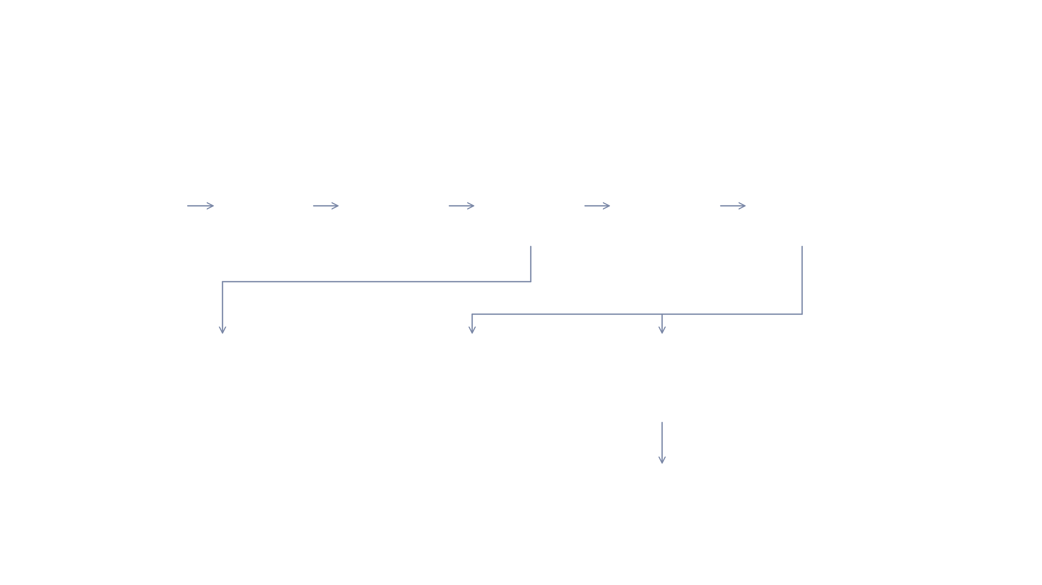










02 — ARCHITECTURE
End-to-end data flow
INGESTION LAYER
Apigee Gateway
Event Processor
Apache Kafka
JSON → Parquet batches
S3 / HPOS
Aggregation
MongoDB
ASDE / GW
Parquet · partitioned
Scheduled batch job
Aggregated data store
+
Future source systems
topic: wf.recipient .billable.events
raw S3 → cold storage after 14 months
Archival
Cold storage
Analytics & Dashboards
Monetization Engine
NDM file · monthly (configurable)
Billing System
Receives NDM file
Metering Engine — Architecture & Design
Notes:
The full pipeline. Events enter via Apigee/ASDE to Kafka, are processed to Parquet on S3, aggregated to MongoDB, then fan out to monetization, billing, and analytics. Raw S3 archives to cold storage after 14 months.

Slide 4

03 — INGESTION LAYER
Capture billable events at the edge
Apigee Gateway and ASDE identify billable activity and produce events onto a Kafka topic for downstream processing.
Apigee Gateway & ASDE identify and produce billable events.
Apache Kafka
Events are published to a dedicated Kafka topic as the single ingress for metering.
TOPIC
wf.recipient.billable.events
Designed to extend to additional source systems in future.
PAYLOAD
JSON event per billable action
Metering Engine — Architecture & Design
Notes:
Apigee Gateway and ASDE identify billable activity and produce events onto a dedicated Kafka topic.

Slide 5
04 — EVENT PROCESSOR
From JSON stream to columnar storage
Consumes events from Kafka and converts batches into Parquet files written to HPOS (S3), partitioned by date.
Consumes events (JSON) from the Kafka topic wf.recipient.billable.events.
PARTITION PATH
s3://bucket/ year=2025/month=11/day=14/
Converts batches of events into Parquet files and stores them to HPOS.
FORMAT
Parquet
Files are partitioned by date for efficient downstream reads.
HPOS (S3)
STORE
Metering Engine — Architecture & Design
Notes:
The Event Processor consumes JSON from Kafka, batches it into Parquet, and writes date-partitioned files to S3/HPOS.

Slide 6
05 — AGGREGATION LAYER
Enrich, aggregate, and persist
A scheduled batch job turns raw events into priced, aggregated records ready for reporting and billing.
SCHEDULE
READ
ENRICH
WRITE
Scheduled batch job
Raw events from S3
Pricing configuration
Writes to MongoDB
Runs hourly or daily.
Reads partitioned Parquet.
Applies pricing config.
Used for reporting.
AGGREGATES BY — based on configuration
Day
Customer
Application
Product
API
Metering Engine — Architecture & Design
Notes:
A scheduled batch job reads raw events from S3, enriches with pricing config, aggregates across dimensions, and writes results to MongoDB.

Slide 7

06 — AGGREGATED DATA STORE
MongoDB
A lightweight store holding only the aggregated output — optimized for the reads that power monetization and analytics.
Aggregated only
Smaller footprint
Fast queries
Stores only aggregated data — no raw events.
A much smaller storage footprint than raw.
Fast query performance for reporting.
Metering Engine — Architecture & Design
Notes:
MongoDB stores only aggregated data — a much smaller footprint with fast query performance.

Slide 8
07 — ANALYTICS & DASHBOARDS
Reporting on the aggregated data
Dashboards present the aggregated data through a detailed interface, reading from MongoDB based on the selected filters.
Represents aggregated data in different reporting formats with a detailed user interface.
Reads data from MongoDB based on the filters applied in the dashboard.
Builds dashboards for analytics and reporting.
Metering Engine — Architecture & Design
Notes:
Dashboards read aggregated data from MongoDB based on user filters and present it in multiple reporting formats.

Slide 9



08 — ARCHIVAL
Tiering raw data to cold storage
Raw data on S3 is retained hot for active processing, then aged out to cold storage.
Raw S3 data
after 14 months
Cold storage
Hot · actively processed
Archived · low cost
Metering Engine — Architecture & Design
Notes:
Raw S3 data is moved to cold storage after 14 months.

Slide 10

09 — MONETIZATION ENGINE
Turning usage into billing
Reads aggregated data from MongoDB, applies business and pricing rules, and delivers billing files to the Billing System.
Reads the data from MongoDB.
DELIVERY CADENCE
Applies billing-related business rules.
Monthly — default
Applies pricing rules.
Configurable: daily / weekly / monthly.
Prepares billing records for each event by mapping with ACO billing data requirements .
→ Billing System
Prepares the file and NDMs it to the Billing System.
Receives the prepared NDM file
Metering Engine — Architecture & Design
Notes:
The Monetization Engine reads from MongoDB, applies billing and pricing rules, prepares billing records mapped to ACO requirements, and NDMs a file to the Billing System on a configurable cadence — monthly by default.

